Slide 1
The tableau hr scorecard : measuring success in talent management
1.INDRODUCTION:
Talent means aptitude, skill, or the ability to perform a particular work or job. According to the lexicon of management, talent refers to identification, inculcation, utilization, and retention of a set of skills or abilities of the employees in the interest of the organization.

Slide 2
1.1 OVER VIEW
Talent management, sometimes referred to as human .Capital management, is the strategic practice of acquiring, on boarding, developing, retaining, and transitioning employees to help build an organization’s culture engagement, capability, and capacity.

Slide 3
1.2 Purpose
Purpose of talent management is to identify recruit and hold an to people who dive the success of you organization.
It’s a top priority, strategic process for forward- looking people companies who understand that their company performance depends on their workforce.
Performance and talent management is a key function of the modern HR department

Slide 4
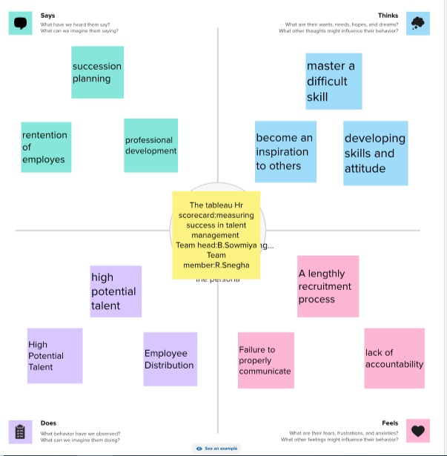
2.Problem definition and design thinking
2.1 EMPATHY MAP:

Slide 5
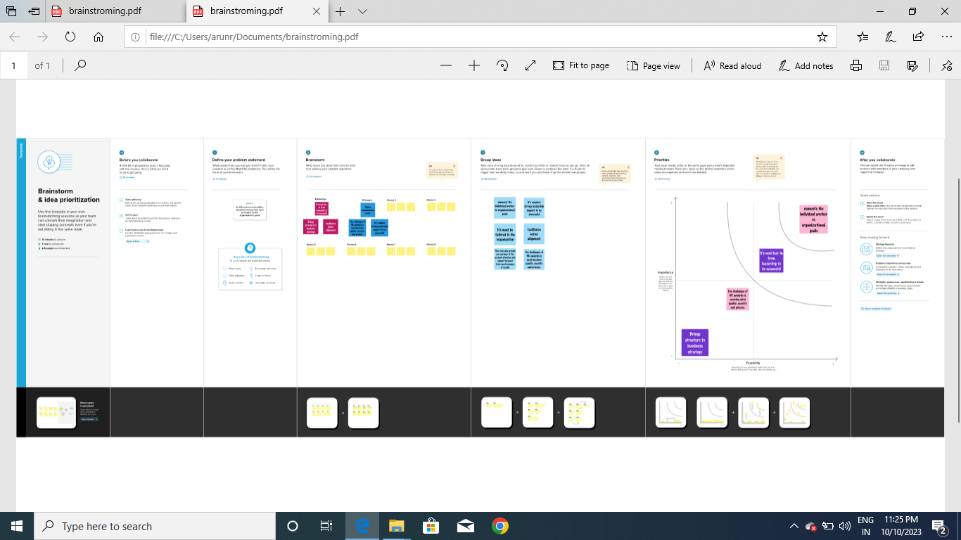
2.2 BRAINSTROMING MAP:

Slide 6
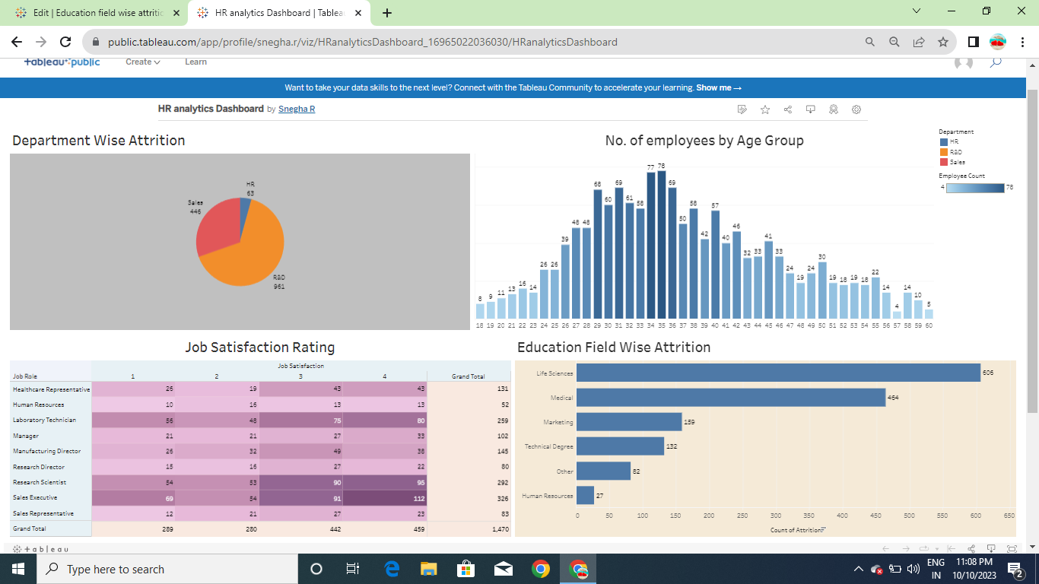
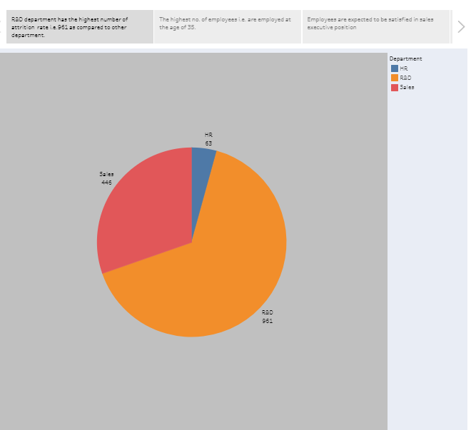
3. RESULT:
DASHBOARD
STORYLINE

Slide 7
4.ADVANTAGES:
Help in ascertaining the right person is deployed in the right position.
Contribution in retaining their top talent.
Better hiring by hiring assessments
Helps in understanding employees better and shaping their future.
Promotes effective communication across different disciplines.
DISADVANTAGES:
The implementation of talent management program could be expensive in terms of time, resources and financial costs.
Lack of support from line mangers can impede the level of commitment from employees.
A core drawback of talent management is , it can contribute in raising the conflicts between HR and management by not reaching to proper agreement consensus.

Slide 8
5.APPLICATIONS:
Help companies hire,
Measure performance,
Develop,
Reward and establish succession plant for their workforce,
A talent management system is an integrated software platform that supports the entire employee lifecycle.

Slide 9
6.CONCLUSION:
Talent management in an organization aims to ensuring employee recruitment, training and development, performance reviews and their compensation.

Slide 10
8.FUTURE SCOPE:
Talent management is the full scope of HR process o attract, on board, develop, motivate, and retain high-performing employees.
Talent management is aimed at improving business performance through practices that make employees more productive.

Slide 11
THANK YOU

